Slide 1



Data Science Methods for Clean Energy Research (DSMCER)
Knowledge and solutions for a changing world
Advancing data-intensive discovery in all fields
Be boundless
UW DIRECT
(Data Intensive Research Enabling Cutting-edge Tech)
https://uwdirect.github.io
Ting Cao
Materials Science & Engineering
Dave Beck (dacb)
eScience/Chemical Engineering
Notes:
In the SEDS portion of the class, we mostly focus on structure rather than content: knowing how to interact with the Shell, getting familiar with Github tools, etc. But in the DSMCER lectures, we’re going to focus more on content: on solving particular problems with the tools we learn about in SEDS. Know, the DSMCER material is also a set of tools that can be applied to a wide set of problems: and we aren’t going to get too mired down in any one domain science. But there is a difference.
Let me tell you about my experience with data science. I came to the University of Washington with absolutely no idea what “data science” meant. I had a little MatLab coding experience, but I found any type of computational work outright intimidating. So maybe a lot like you. And when I got started with programming, I was a little impatient with all this SEDS stuff. All this git add, git commit, git pull– it added nothing of value to my immediate problem! It didn’t help me analyze my data, etc. It only came over time working in the eScience Institute with data scientists that I began to see its value. So don’t give up yet.
Today, we’re going to focus on a subset of problems within data science, what we’re referring to as data visualization. So making pretty graphs. Kind of a fun one right?
By the end of today, I want you to feel comfortable using a few basic tools within three Python packages (Pandas, Matplotlib, and Seaborn) that can help you make some simple graphs.
I was you to feel comfortable accessing reference materials online to do more complex operations to make your graphs even prettier.
And I want to give you a few guiding principles when designing figures, plots, and graphs.
And ultimately, I want to convince you that you can and should try making your plots with Python instead of alternatives such as Excel or more sophisticated programs like GraphPad.

Slide 2
What makes a good graph?
Science (including Statistics)
Showmanship
Readability
Notes:
I don’t want this to come off as a polemic against Excel, but I do.
Pull out an Excel spreadsheet and talk about differences.
Ultimately, Excel only suffers from some dreary default behavior that can make meetings horrible after you’ve seen enough bad graphs in a bad Powerpoint presentation.
And limited default visualizations.

Slide 3
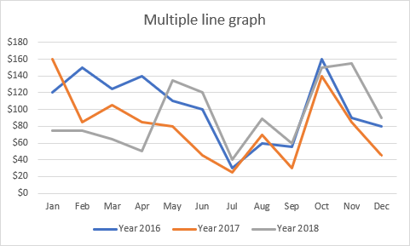
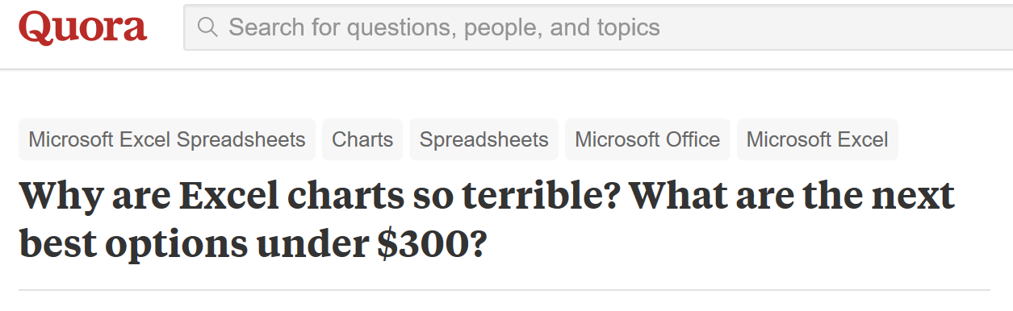
Learning by unexample
Notes:
I don’t want this to come off as a polemic against Excel, but I do.
Pull out an Excel spreadsheet and talk about differences.
Ultimately, Excel only suffers from some dreary default behavior that can make meetings horrible after you’ve seen enough bad graphs in a bad Powerpoint presentation.
And limited default visualizations.

Slide 4
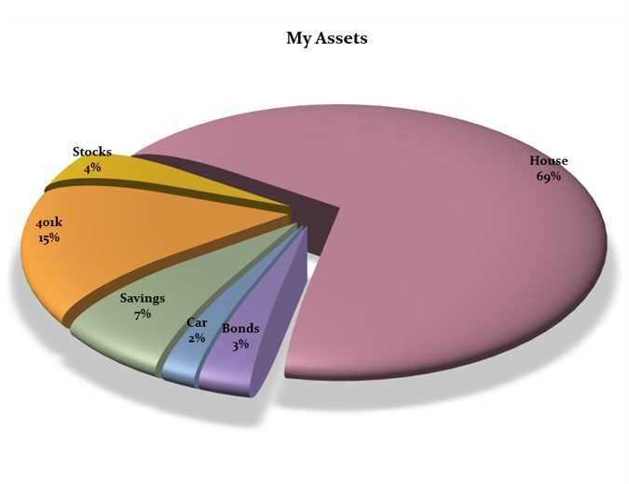
What is wrong with this figure?
https://blog.funnel.io/why-we-dont-use-pie-charts-and-some-tips-on-better-data-visualizations

Slide 5
Learning by unexample

Slide 6
Learning by unexample
Coronal mass ejection
Amari et al. Nature (Wired best vis of 2014)

Slide 7
Learn by un-example?
10 minute exercise
Turn to a neighbor
Introduce yourself
Department
Research area
Favorite color
Find the worst scientific visualization you can

Slide 8
Show and share
Drop URLs to your worst figures in Slack
I’ll bring them up on the screens for us to discuss

Slide 9
Basic principles
Know your audience
What are the expectations?
Error bars?
Units?
Axis labels?
Are they experts?
https://www.informationisbeautifulawards.com/news/118-the-nyt-s-best-data-visualizations-of-the-year

Slide 10
Basic principles
Know your message
What exactly are you trying to convey?
How does it fit into the narrative of your presentation, manuscript, etc.?
How do you make figures for a manuscript?
Text then figure?
Figure then text?

Slide 11
Basic principles
Know your medium
Is your medium static?
What colors does it support? Backlighting?
Does it support 3D?
What about 4D?
Whole poster infographic?

Slide 12
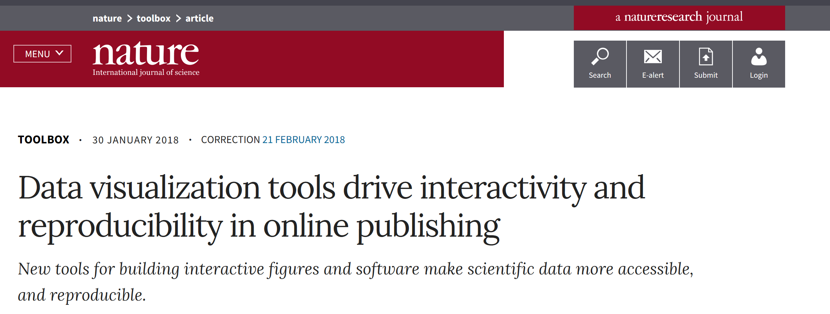
Basic principles
https://bokeh.pydata.org/en/latest/docs/gallery.html#gallery
https://altair-viz.github.io/gallery/index.html
Notes:
https://www.nature.com/articles/d41586-018-01322-9

Slide 13
Basic principles
Text isn’t optional
What do I mean here?
Captions
Axis labels
Legends

Slide 14
Basic principles
Color is important
Why?
What are you trying to accomplish with color?
Diverging vs. sequential
Perceptually uniform colormaps
Viridis
Click this link:
http://colorbrewer2.org

Slide 15
Basic principles
Color is important
~10% of people have some form of color blindness
Deuteranomaly
Red / Green “confusion”
~8% of men
Alternative to default Red / Green
Magenta / Cyan

Slide 16
Basic principles
Do no evil
There is a fine line between changing a visualization to show a scientific conclusion and implying a scientific conclusion by changing a visualization
http://journals.plos.org/ploscompbiol/article?id=10.1371/journal.pcbi.1003833

Slide 17
Basic principles
Avoid chartjunk (taken from PLOS article)
http://journals.plos.org/ploscompbiol/article?id=10.1371/journal.pcbi.1003833

Slide 18
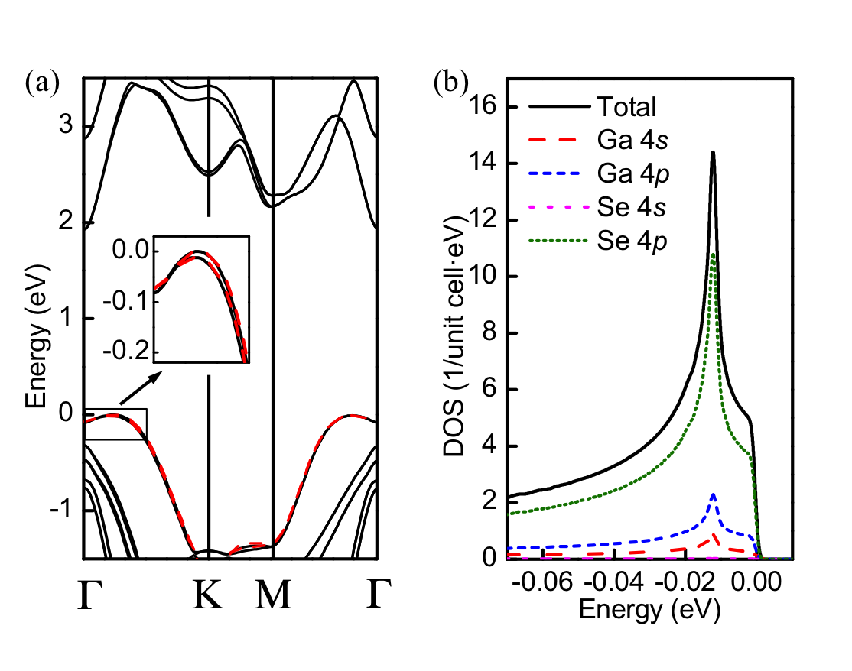
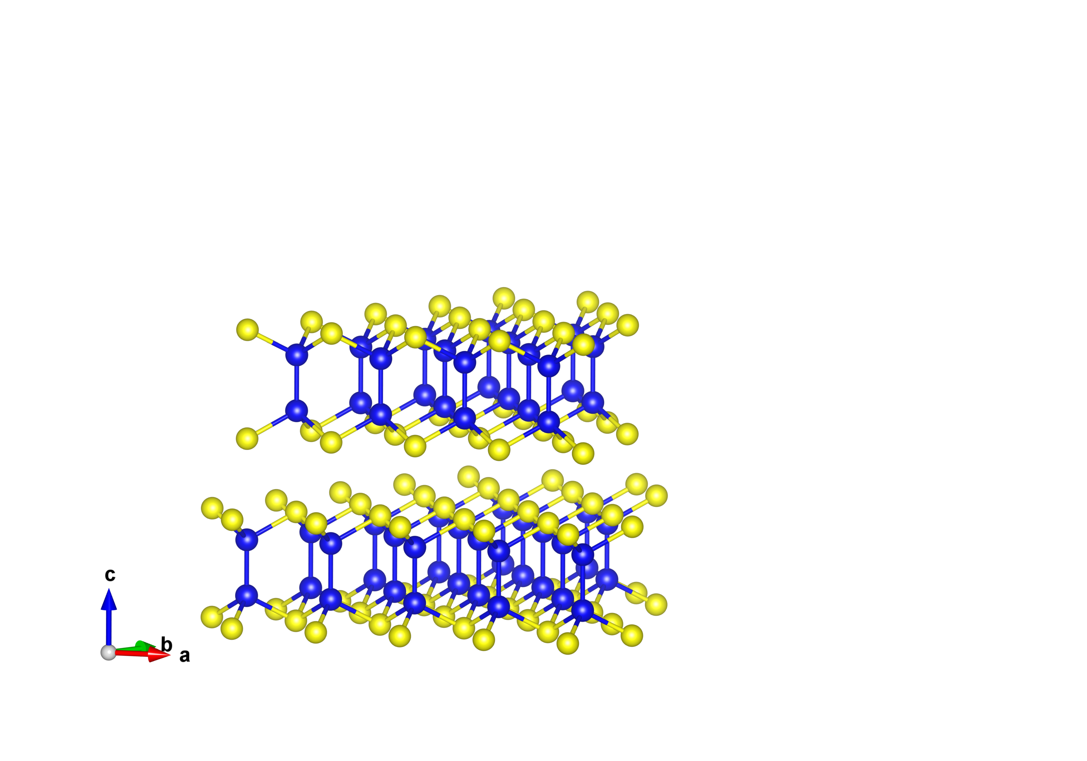

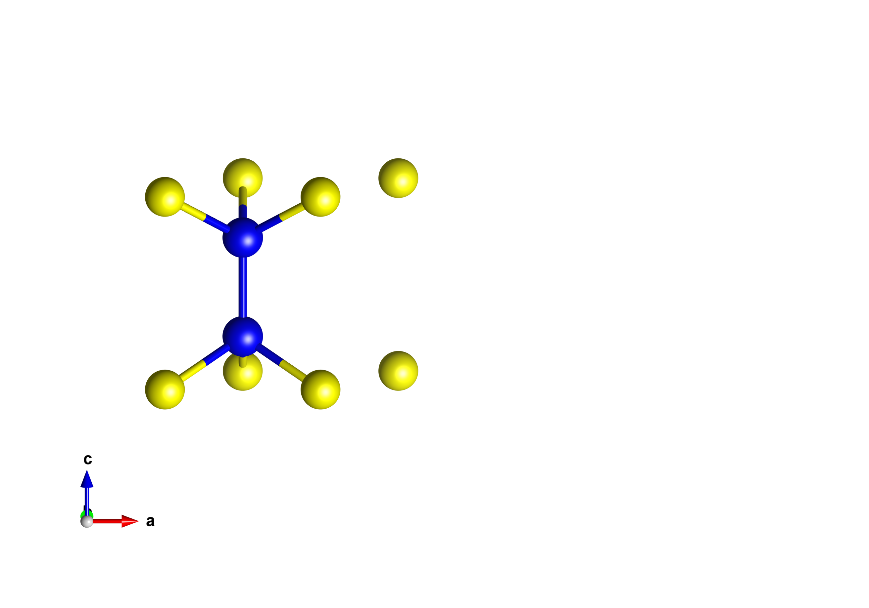
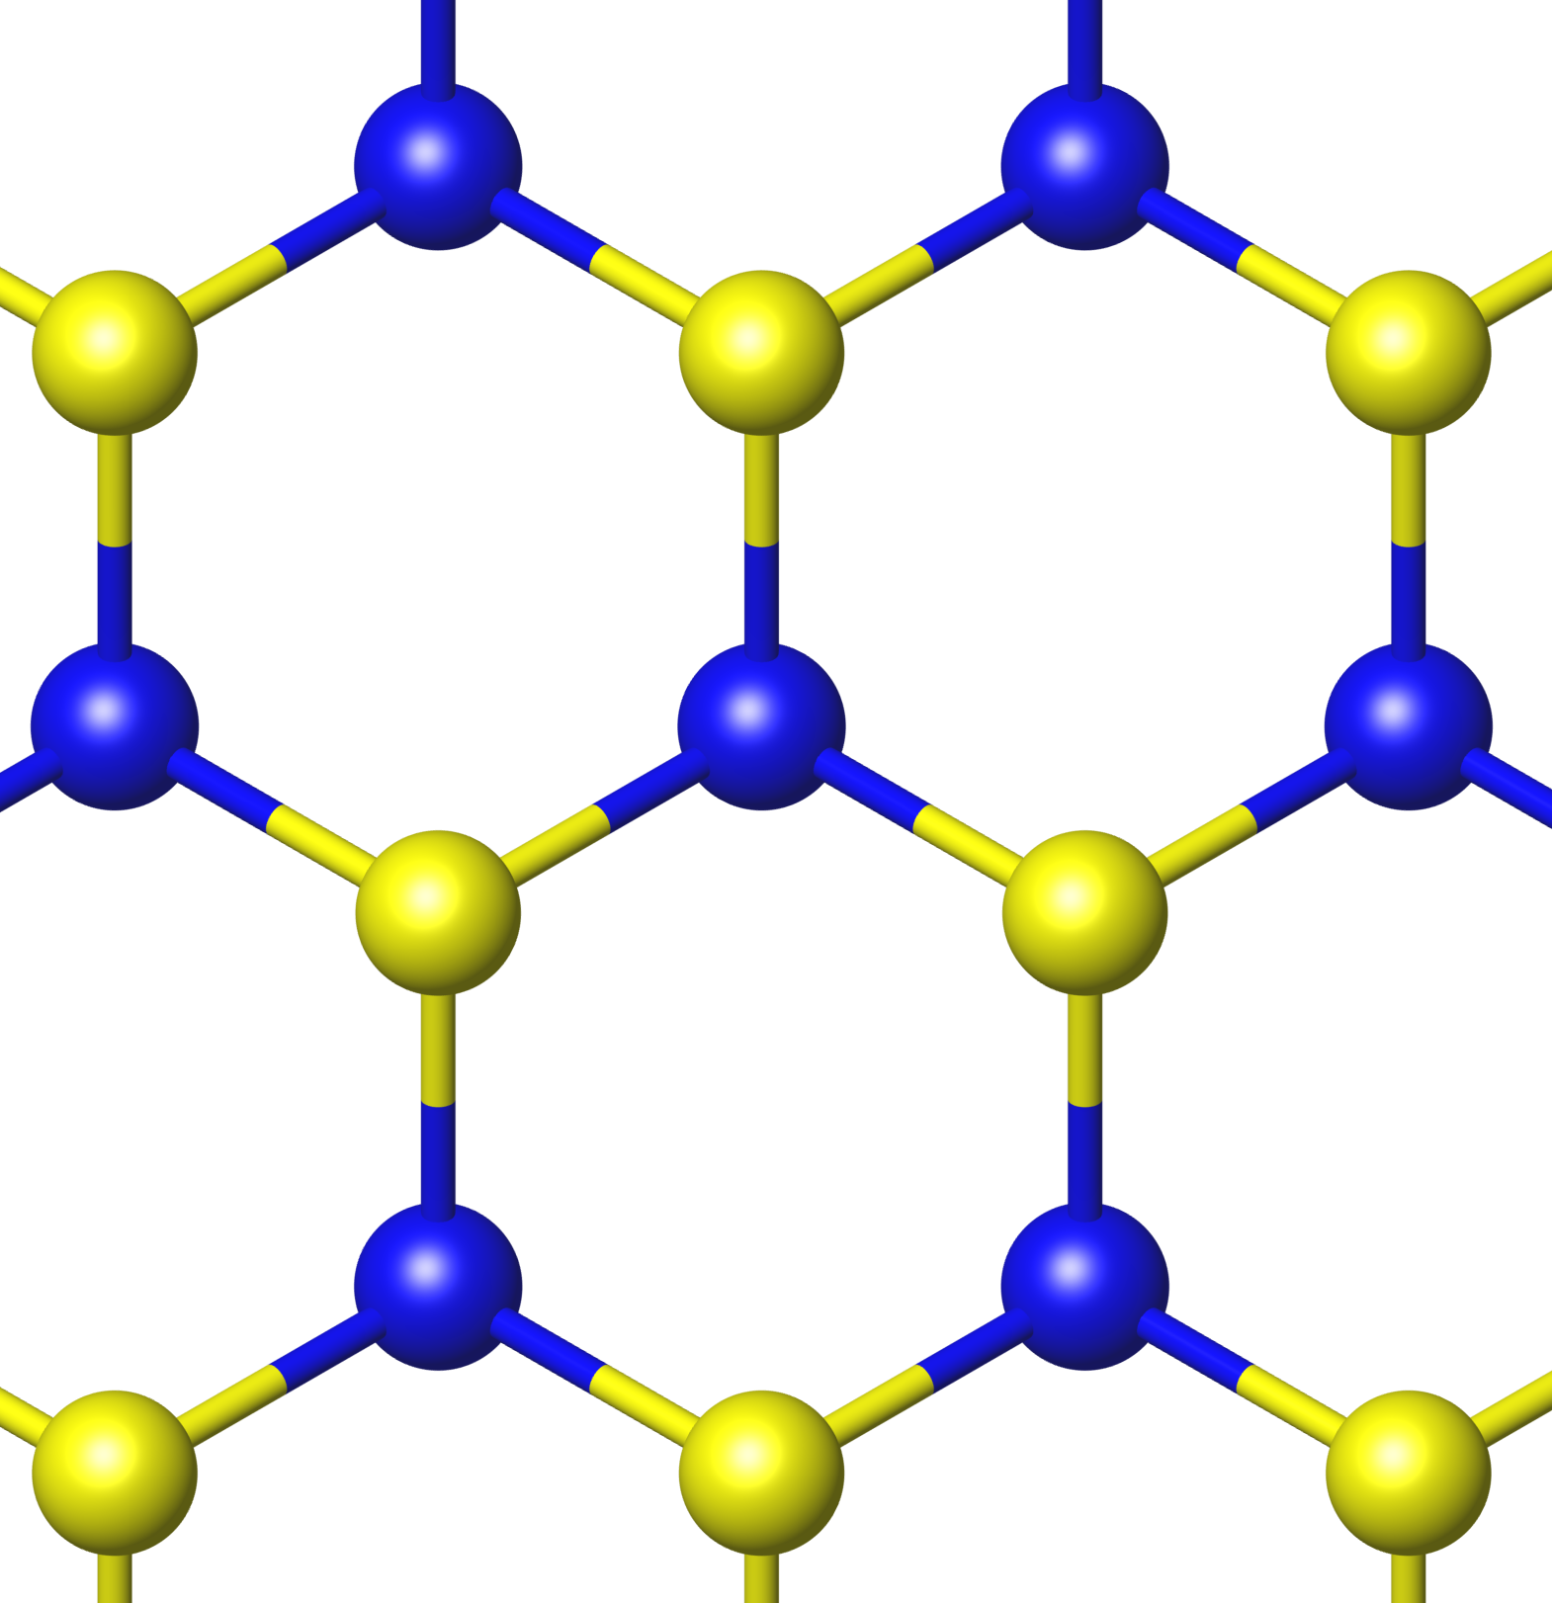
Some Examples
Monolayer GaSe
Band Structure
Density of States
LDA
GW
Se
Se
Ga
Ga
E_{g}(LDA) = 2.0 eV
E_{g}(GW) = 3.7 eV
TC, Li, Louie, PRL (2015)

Slide 19
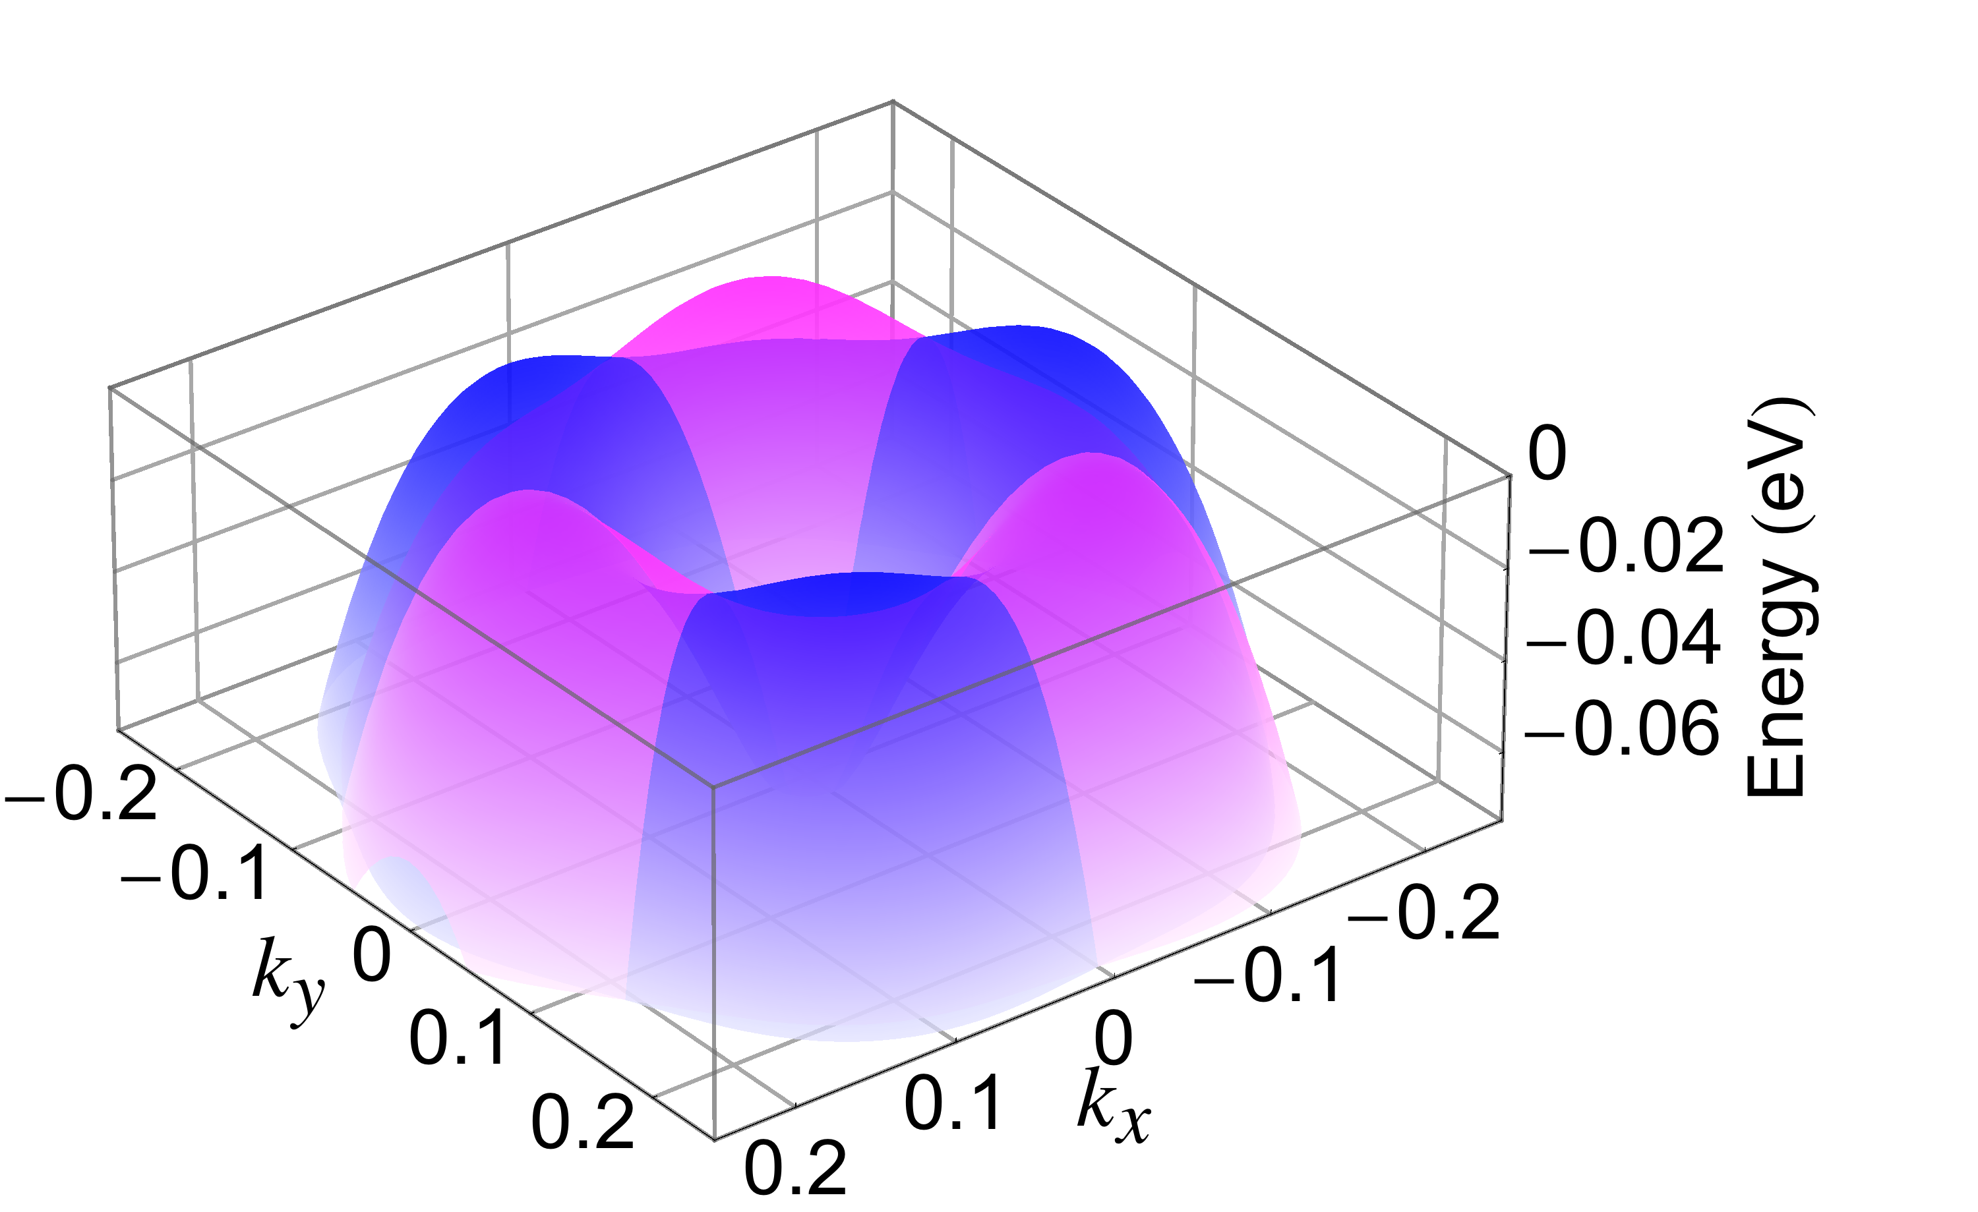
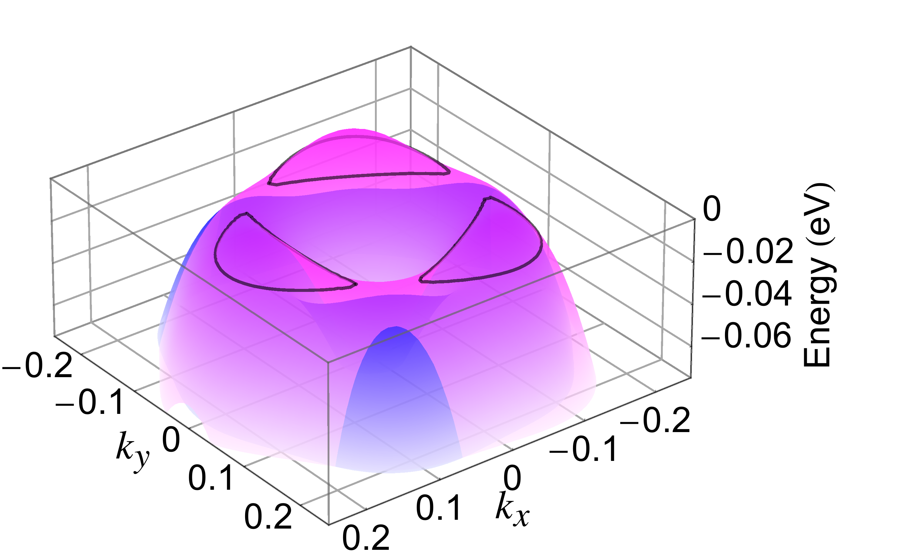
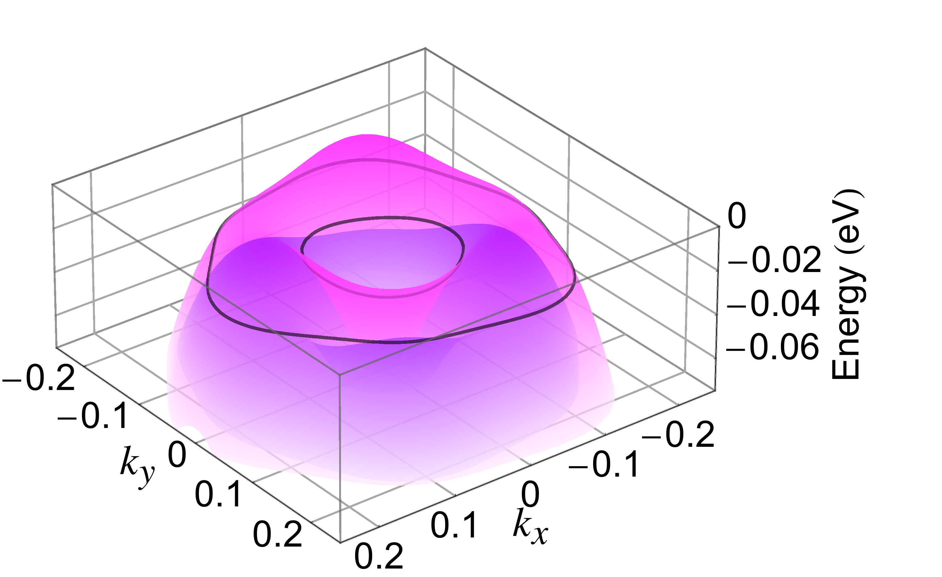
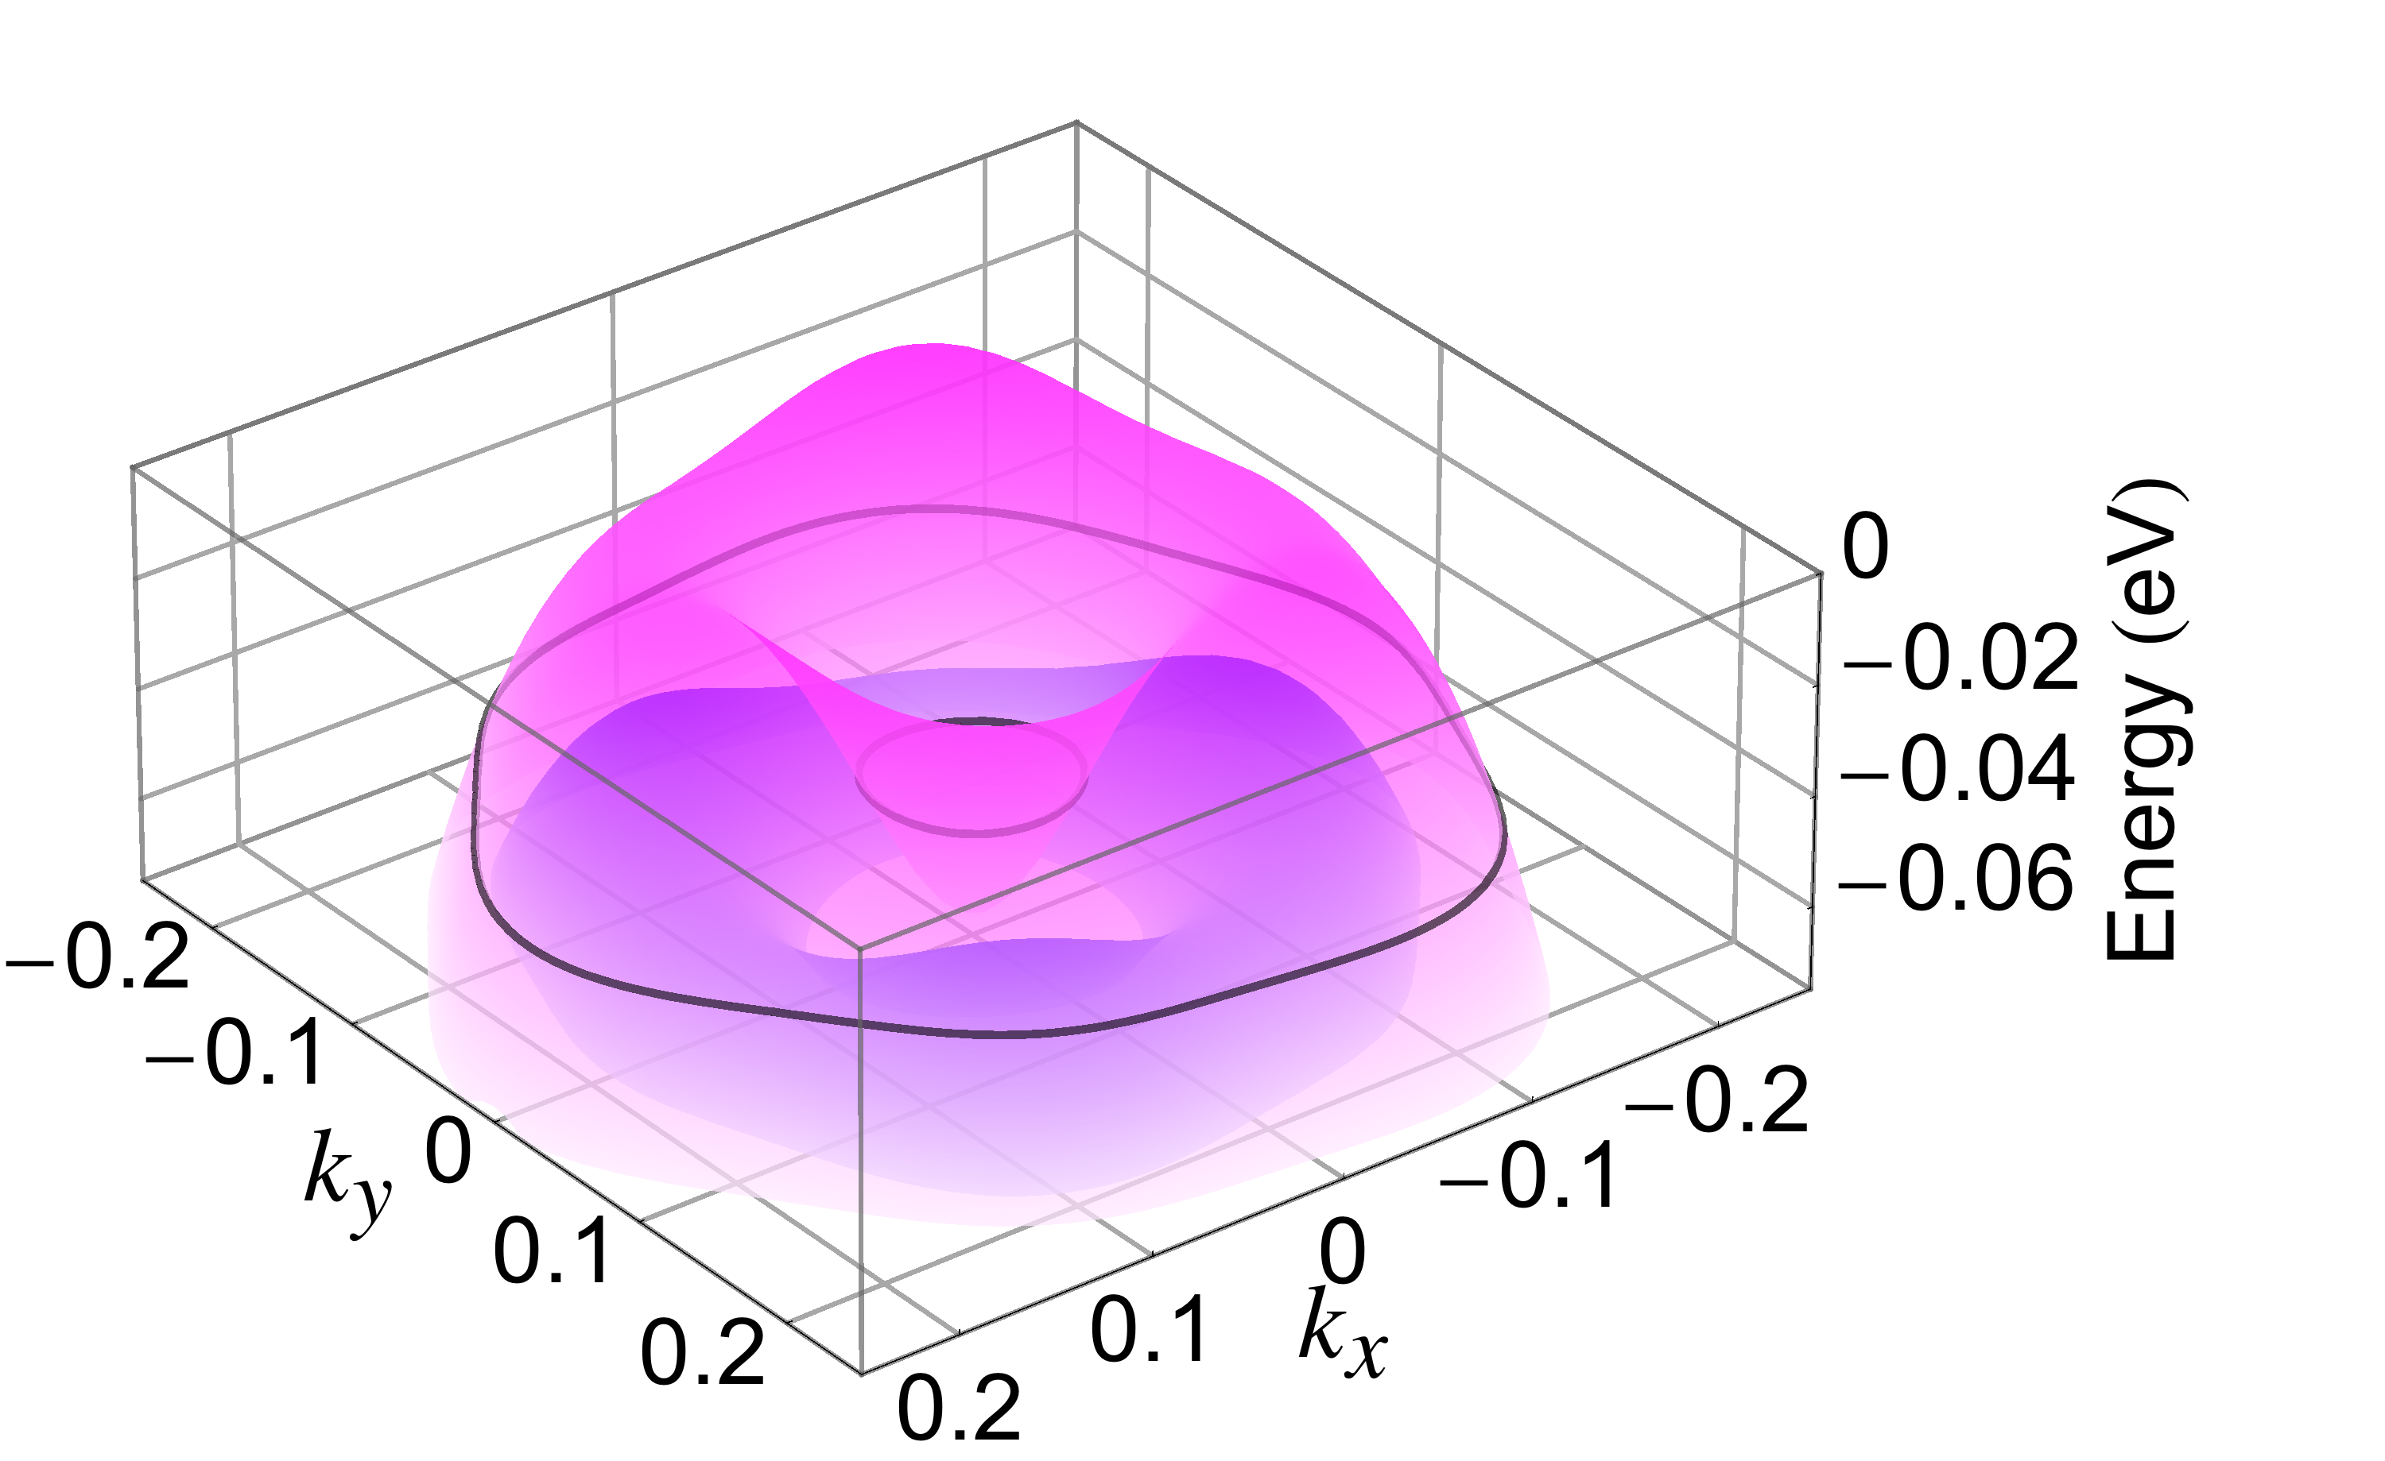
Some Examples
Purple: Spin UP
Blue: Spin DOWN
TC, Li, Louie, PRL (2015)

